Slide 1
Ministry/ Organization name: Govt. Of Goa
Problem Statement : Virtual Tourist Guide [DR135]
1.Higher Cost issues for tourists 2.Unknown landmarks and Miss-guidance to the tourists 3.Language barriers of tourist guides 4.Trust issues faced by the tourists 5. Huge decrease in tourists since 2017 Team Name : Sinister Six
Team Leader Name : Varnekar Shashank Ravindra
College Code : 6270

Slide 2
Idea / Solution :
VIRTUAL TOURIST GUIDE : is the Android application based system for Govt. of Goa which will act as a virtual guide for tourists.
1.Cheapest guide you can hire in Goa.
2.Just click the picture and know the place.
3.Enjoy your vacation as per your personal time and space
4.Solving Trust issues by providing the perfect information.
5. Notification of nearby landmarks with ratings of the same.
6.Text to speech for multiple languages by 1st person narration.
We promise you Increase in Tourist by the end of the year.

Slide 3
Technology Stack:-
Programming Language : Java/Dart
Toolkit: Android Studio, Android Developer Tools/ Flutter
SDK: Android SDK, Flutter SDK
Machine Learning Algorithm : Image Recognition
Firebase
APIs by Google
Dependencies / Show stopper:-
1.User Sign in
2.Image Input
3.GPS Access
4.Internet Access

Slide 4
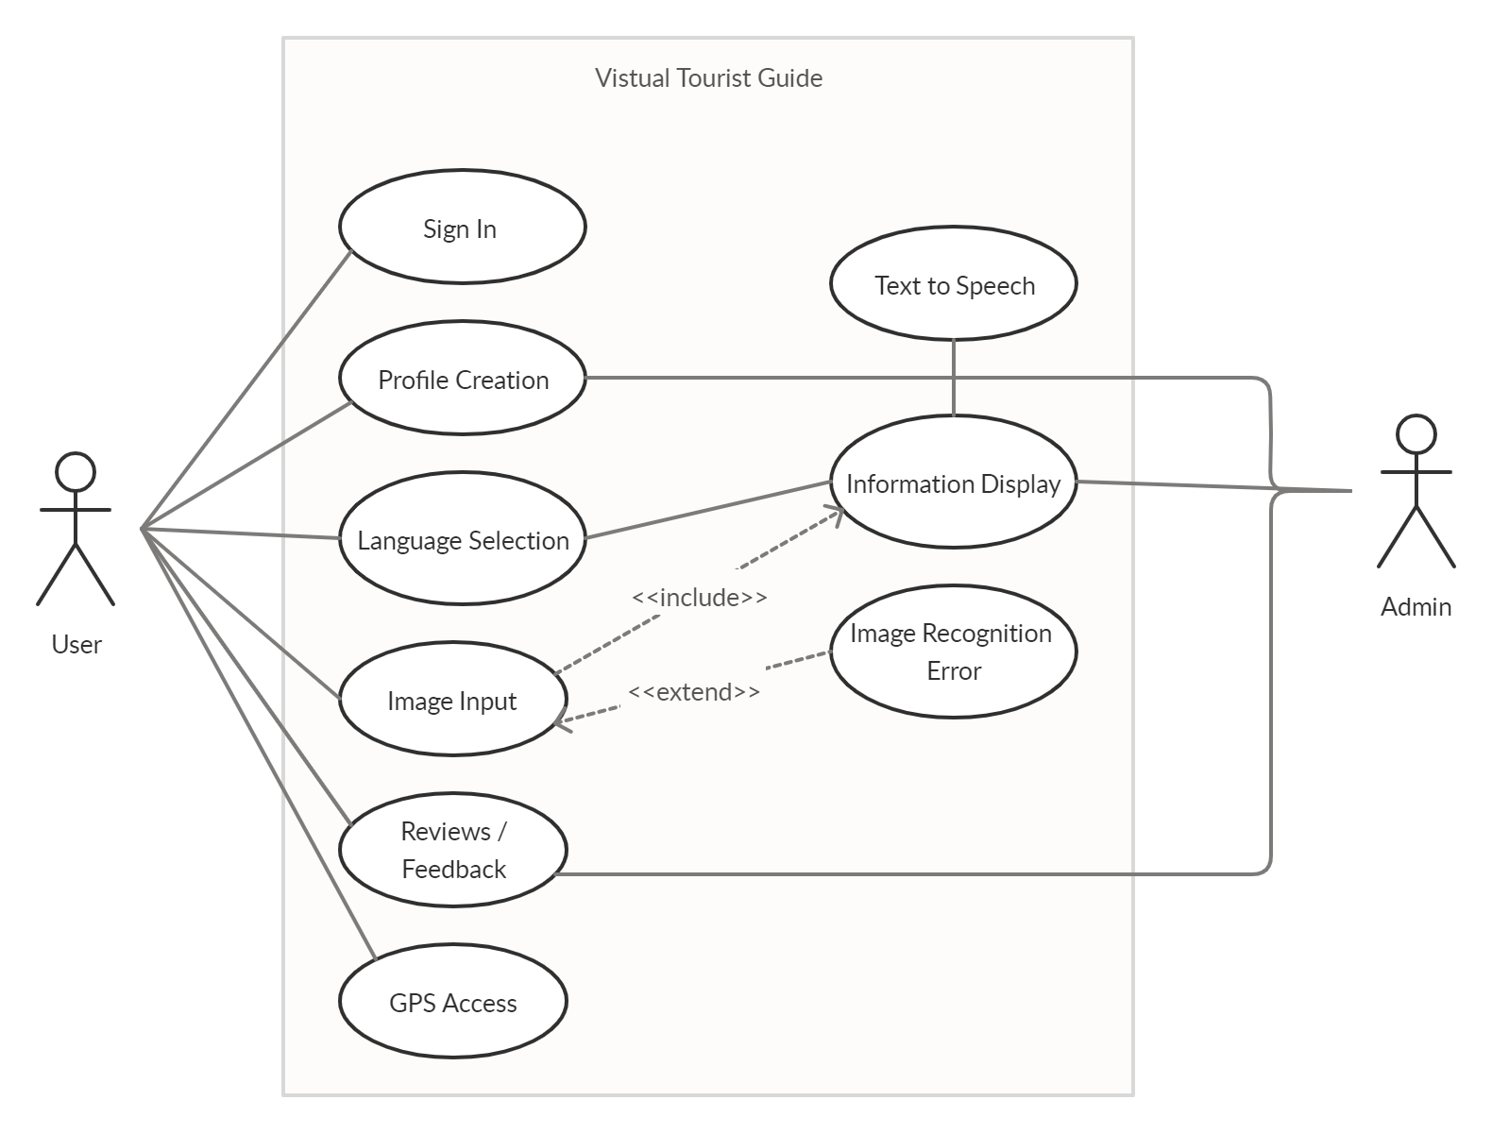
Use- Case Diagram
z

